Slide 1
AFGHANISTAN
When and How will America’s longest war end?
By:
Baher Ghosheh
Edinboro University

Slide 2
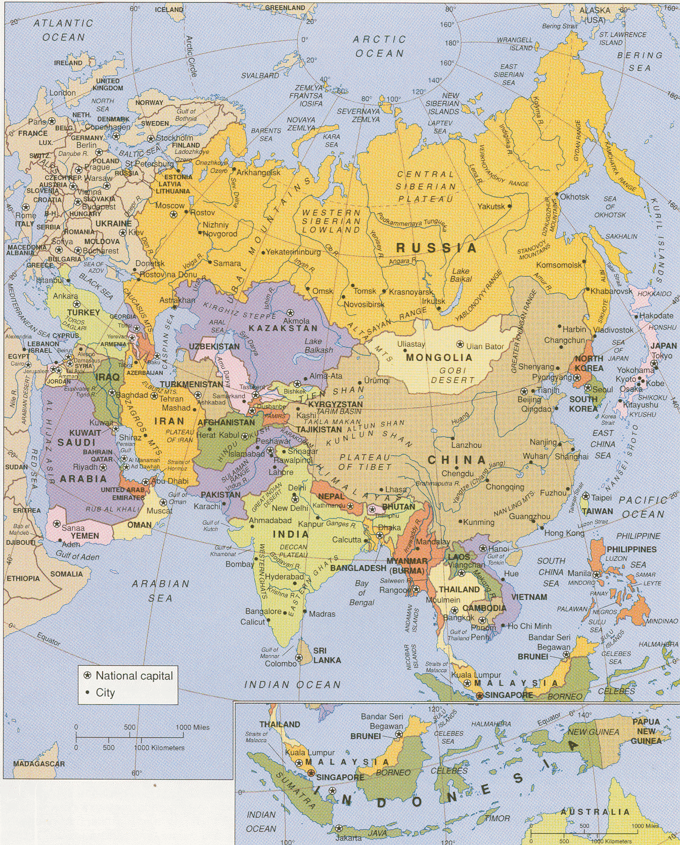
Afghanistan
SOURCE: https://legacy.lib.utexas.edu/maps/afghanistan.html

Slide 3
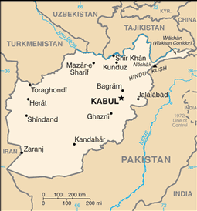
Afghanistan
SOURCE: http://muslimnews.co.uk/news/middle-east/afghanistan-attack-govt-compound-kills-43/

Slide 4
Afghanistan
It was at the centre of the so-called "Great Game" in the 19th century when Imperial Russia and the British Empire in India vied for influence.
And it became a key Cold War battleground after thousands of Soviet troops intervened in 1979 to prop up a pro-communist regime, leading to a major confrontation that drew in the US and Afghanistan's neighbors
But the outside world eventually lost interest after the withdrawal of Soviet forces, while the country's protracted civil war dragged on.
(US left after Soviet withdrawal)
The emergence of the Taliban - originally a group of Islamic scholars - brought at least a measure of stability after nearly two decades of conflict.
Taliban controlled to 90% of the country!

Slide 5
Afghanistan
Economy and infrastructure are in ruins, and many of its people are refugees. landlocked and mountainous, Afghanistan has suffered from such chronic instability and conflict during its modern history that its
“One of the world’s poorest countries”
Its strategic position sandwiched between the Middle East, Central Asia and the Indian subcontinent along the ancient "Silk Route" means that Afghanistan has long been fought over .
despite its rugged and forbidding terrain.

Slide 6
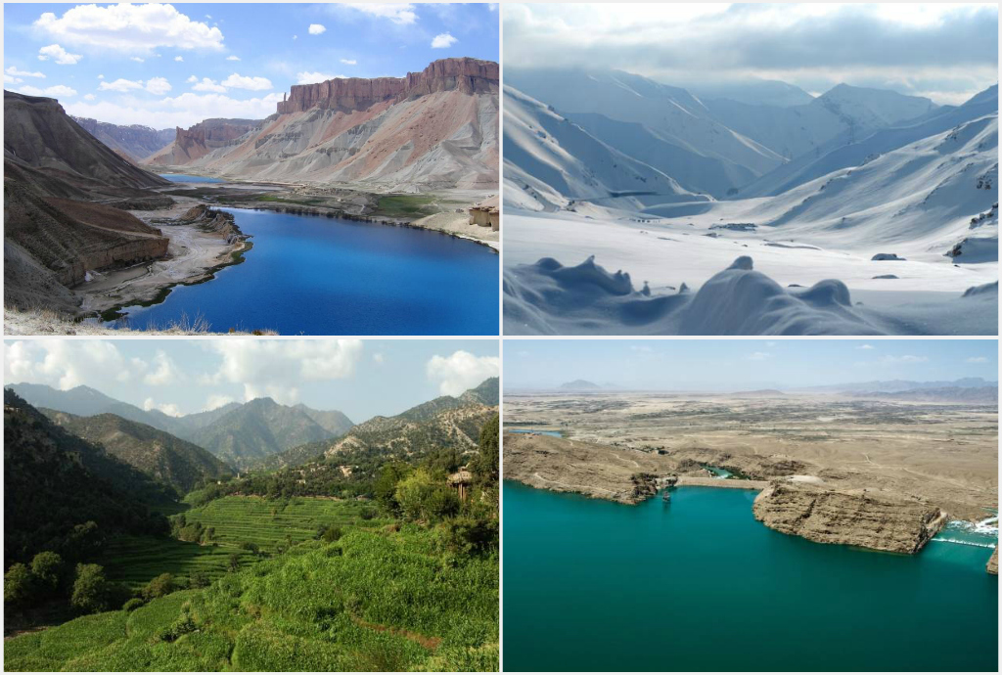
Geography: Landscapes Grave Yard of Empires
SOURCE: https://en.wikipedia.org/wiki/Afghanistan

Slide 7
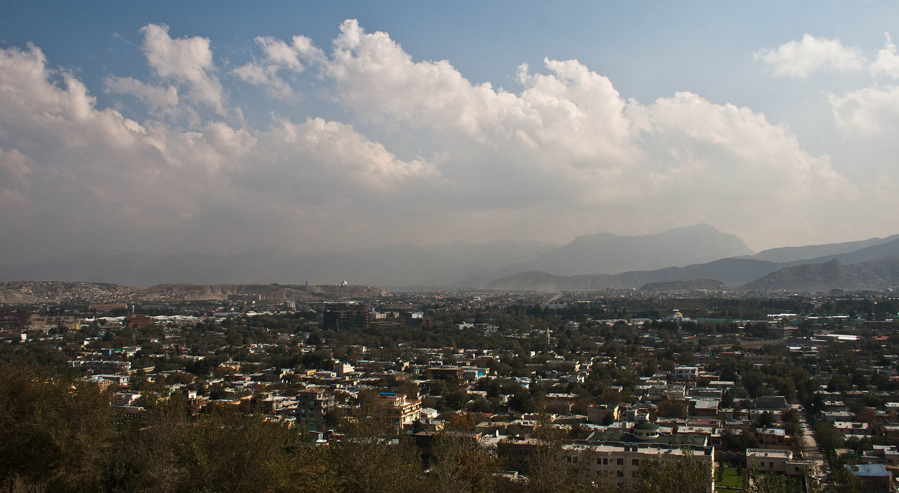
Kabul and Mountains
SOURCE: https://commons.wikimedia.org/wiki/File:Section_of_Kabul_in_October_2011.jpg

Slide 8
Afghanis
For centuries, the region today known as Afghanistan has been predominantly Muslim since Arab invaders encouraged conversion of the local populations from Zoroastrianism, Buddhism, and Hinduism.
The country's nearly impassable mountains and desert terrain have contributed to its ethnically and linguistically diverse population.
Pashtuns are the largest ethnic group in the country; however the national population also consists of Tajiks, Hazara, Aimak, Uzbeks, Uyghur, Turkmen, and other small groups.
Many Soviet Muslims from bordering Central Asian former Soviet republics (eg. Turkmenistan, Uzbekistan and Tajikistan) had ethnic kinship relationships in both Iran and Afghanistan

Slide 9
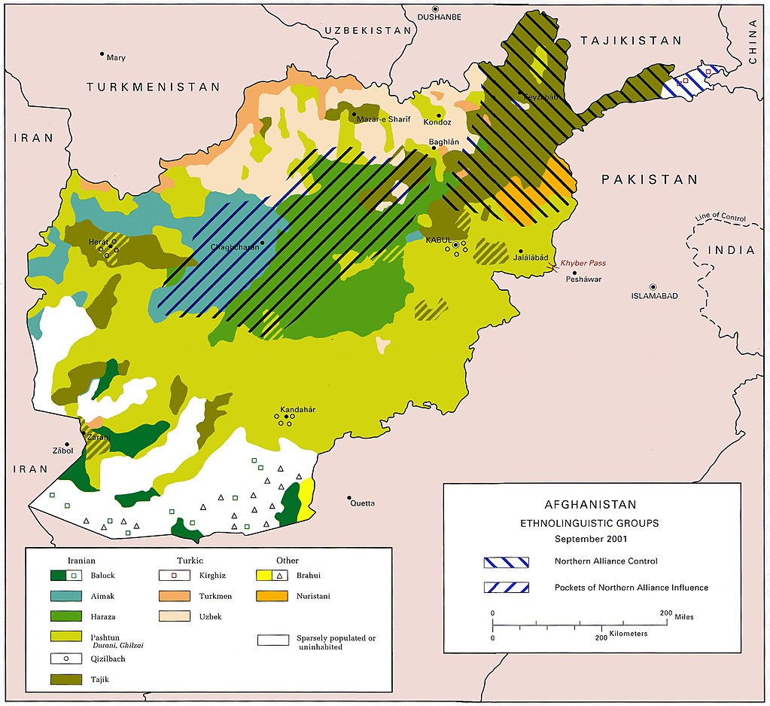
SOURCE: https://commons.wikimedia.org/wiki/File:US_Army_ethnolinguistic_map_of_Afghanistan_--_circa_2001-09.jpg

Slide 10
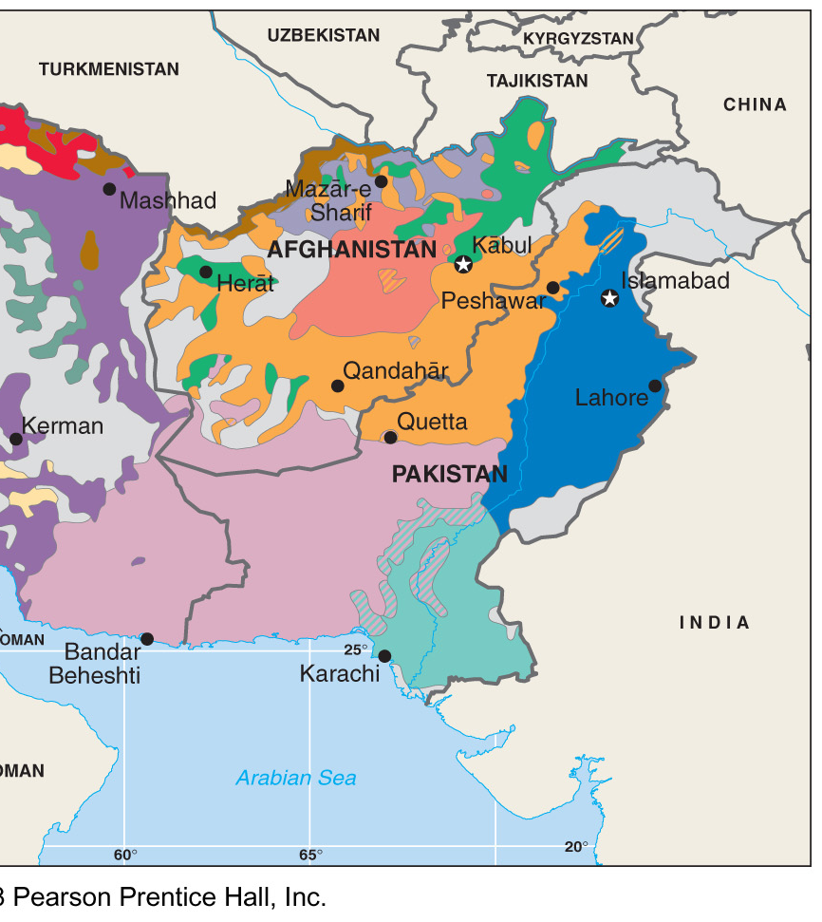
Ethnic and Language Groups
SOURCE: Pearson Prentice Hall, Inc. 2008
Notes:
10
Figure: 08-15
Title:
Ethnic groups in Southwest Asia.
Caption:
During the Cold War, the United States and the Soviet Union viewed conflicts in this region as part of a global struggle in support of or against the spread of communism. More recently, U.S. officials have regarded conflicts in Southwest Asia as part of the global war on terrorism. As the map shows, boundaries between ethnic groups do not match boundaries between countries in Southwest Asia, especially Iraq, Iran, Afghanistan, and Pakistan. This mismatch plays a critical role in the region's many wars.

Slide 11
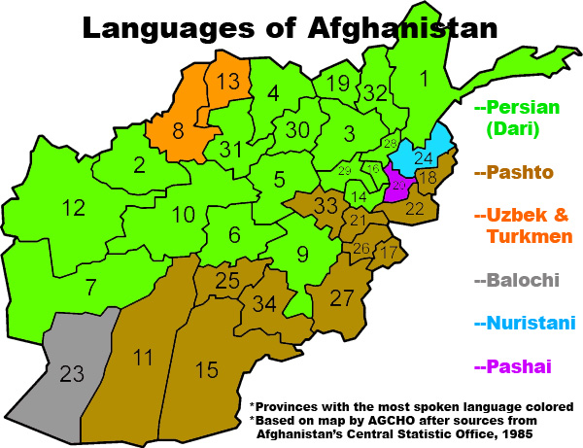
SOURCE: https://vi.wikipedia.org/wiki/Afghanistan

Slide 12
Very Diverse Country Ethnic and Linguistic Diversity
Ethnic groups:
Pashtun 42%
Tajik 27%
Hazara 9%, Uzbek 9%
Aimak 4%, Turkmen 3%, Baloch 2%, other 4%
Religions:
Sunni Muslim 80%, Shia Muslim 19%, other 1%

Slide 13
AFGHANISTAN
Full name: Islamic Republic of Afghanistan
Population: 36 million (2017 Eastimate)
Capital and largest city: Kabul
Area: 652,225 sq km (251,773 sq miles)
Major languages: Pashto, Dari (Persian)
Major religion: Islam
Life expectancy: 48 years (m), 49 years (w)
Up from 40 years a decade ago!!
Monetary unit: 1 Afghani = 100 puls
Main exports: Fruit and nuts, carpets, wool, opium
GNI per capita: n/a ($1060)

Slide 14
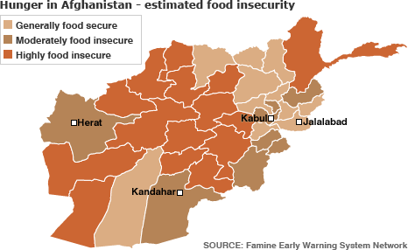
Very Poor Country

Slide 15
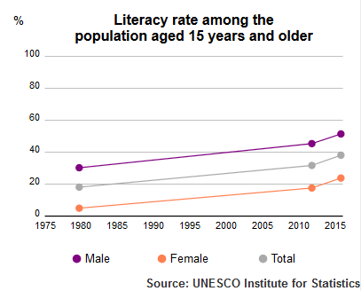

Slide 16
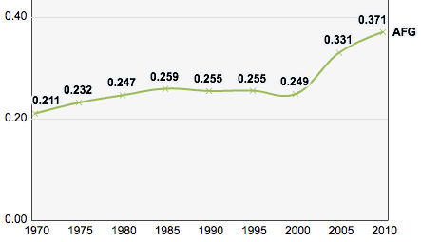
Human Development Index: Things getting Better!!!
SOURCE: https://commons.wikimedia.org/wiki/File:Afghanistan,_Trends_in_the_Human_Development_Index_1970-2010.png

Slide 17
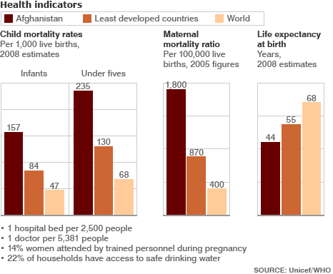

Slide 18
Mostly Illiterate: Taliban: Religious Students!!
90% of the Taliban are illiterate!
Literacy:
definition: age 15 and over can read and write
total population: 28.1%
male: 43.1%
female: 12.6% (some estimated have it at 5%)

Slide 19
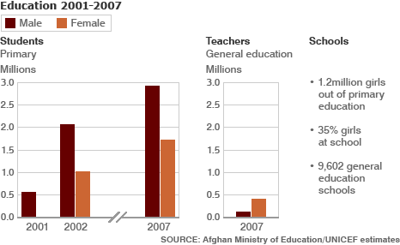

Slide 20
Modern History
Ahmad Shah DURRANI unified the Pashtun tribes and founded Afghanistan in 1747. The country served as a buffer between the British and Russian Empires until it won independence from nominal British control in 1919. A brief experiment in democracy ended in a 1973 coup and a 1978 communist countercoup.
The Soviet Union invaded in 1979 to support the tottering Afghan communist regime, touching off a long and destructive war. The USSR withdrew in 1989 under relentless pressure by internationally supported anti-communist mujahidin rebels.
A series of subsequent civil wars saw Kabul finally fall in 1996 to the Taliban, a hardline Pakistani-sponsored movement that emerged in 1994 to end the country's civil war and anarchy.
Following the 11 September 2001 terrorist attacks, a US, Allied, and anti-Taliban Northern Alliance military action toppled the Taliban for sheltering Usama BIN LADIN.

Slide 21
Soviet Occupation of Afghanistan
This Russian interest in the Afghanistan continued on through the Soviet era, with billions in economic and military aid sent to Afghanistan between 1955 and 1978.
Soviet invaded in 1979 after the government sought help during the Civil War in Afghanistan.
The Soviet troops stayed in Afghanistan to help the communist government and did not leave until 1989.

Slide 22
Rise of the Taliban Un-Holy Alliance
US-Saudi-Pakistani alliance to help defeat the Soviets in Afghanistan
US/SA funded and trained the Mujahideen
SA provided the ideology (Wahabism)
Pakistan provided the Madrassas, training and logistics
More CIA operatives than any country in world
Osama Ben Laden as our ally!

Slide 23
US and Afghanistan in the 1980s
In the mid-1980s, the Afghan resistance movement, assisted by the United States, Pakistan, Saudi Arabia, the United Kingdom, the People's Republic of China and others, contributed to Moscow's high military costs and strained international relations. The US viewed the conflict in Afghanistan as an integral Cold War struggle, and the CIA provided assistance to anti-Soviet forces through the Pakistani intelligence services, in a program called Operation Cyclone.
A similar movement occurred in other Muslim countries, bringing contingents of so-called Afghan Arabs, foreign fighters who wished to wage jihad against the atheist communists. Notable among them was a young Saudi named Osama bin Laden, whose Arab group eventually evolved into al-Qaeda.

Slide 24
Modern History
1979 - Soviet Army invades and props up communist government. More than a million people die in the ensuing war.
1989 - Last Soviet troops leave. US- and Pakistan-backed mujahideen push to overthrow Soviet-installed Afghan ruler Najibullah triggers devastating civil war.
Najibullah and his communist government fell to the mujahideen
1996 - Taliban seize control of Kabul and impose hard-line version of Islam.
2001 - US intervenes militarily following September 11 attacks on the United States. Taliban are ousted from Kabul and Hamid Karzai becomes head of an interim power-sharing government.
2002 - Nato assumes responsibility for maintaining security in Afghanistan.
2004 - Loya Jirga adopts new constitution which provides for strong presidency. Hamid Karzai is elected president.
2014 - Ashraf Ghani elected president. NATO formally ends its combat mission in Afghanistan, handing over to Afghan forces, who face a growing insurgency.

Slide 25
Destruction in Afghanistan
Estimates of the Afghan deaths vary from 100,000 to 2 million
5 million Afghans fled to Pakistan and Iran, 1/3 of the prewar population of the country. Another 2 million Afghans were displaced within the country. In the 1980s, half of all refugees in the world were Afghan
Along with fatalities were 1.2 million Afghans disabled (mujahideen, government soldiers and noncombatants) and 3 million maimed or wounded (primarily noncombatants).
Irrigation systems, crucial to agriculture in Afghanistan's arid climate, were destroyed by aerial bombing and strafing by Soviet or government forces. In the worst year of the war, 1985, well over half of all the farmers who remained in Afghanistan had their fields bombed, and over one quarter had their irrigation systems destroyed and their livestock shot by Soviet or government troops, according to a survey conducted by Swedish relief experts.
The population of Afghanistan's second largest city, Kandahar, was reduced from 200,000 before the war to no more than 25,000 inhabitants, following a months-long campaign of carpet bombing and bulldozing by the Soviets and Afghan communist soldiers in 1987.^{[88]} Land mines had killed 25,000 Afghans during the war and another 10–15 million land mines, most planted by Soviet and government forces, were left scattered throughout the countryside.

Slide 26
Taliban, Al-Qaeda and Afghan Arabs Defeat Soviets!!
Ideological impact
The Islamists who fought also believed that they were responsible for the fall of the Soviet Union. Osama bin Laden, for example, was asserting the credit for "the collapse of the Soviet Union ... goes to God and the mujahideen in Afghanistan ... the US had no mentionable role," but "collapse made the US more haughty and arrogant
Taliban control 90% of the country in 1996 with Pakistani assistance…

Slide 27
US Led Invasion of Afghanistan
The War in Afghanistan began on October 7, 2001, as the US military's Operation Enduring Freedom (OEF) that was launched, along with the British military, in response to the September 11, 2001 attacks on the US.
The first phase of the war was the aftermath of the attacks of September 11, 2001, when the United States launched Operation Enduring Freedom, to remove the safe haven to Al-Qaeda and its use of the Afghan territory as a base of operations for terrorist activities. In that first phase, U.S. and coalition forces, working with the Afghan opposition forces of the Northern Alliance, (non-Pashtuns) quickly ousted the Taliban (Pashtun) regime.
During the following Karzai administration, the character of the war shifted to an effort aimed at smothering an insurgency hostile to the US-backed Karzai government, in which the insurgents preferred not to directly confront the International Security Assistance Force (ISAF) troops, but blended into the local population and mainly used improvised explosive devices (IEDs) and suicide bombings

Slide 28
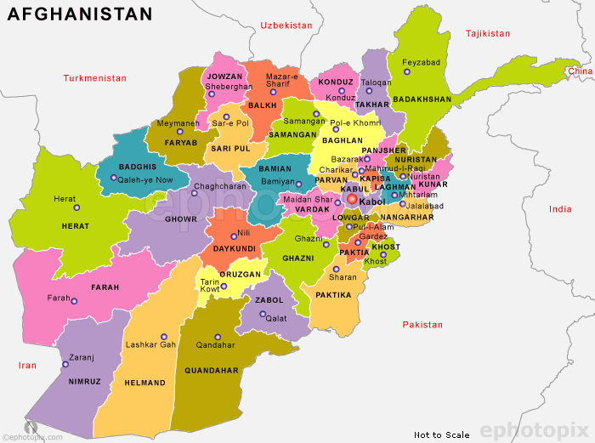
SOURCE: https://www.nunn.asia/92620/%d8%a7%d9%81%d8%ba%d8%a7%d9%86%d8%b3%d8%aa%d8%a7%d9%86-%d8%b2%d8%a7%d8%b1%db%8d-%da%a9%d9%88%d9%8a/

Slide 29
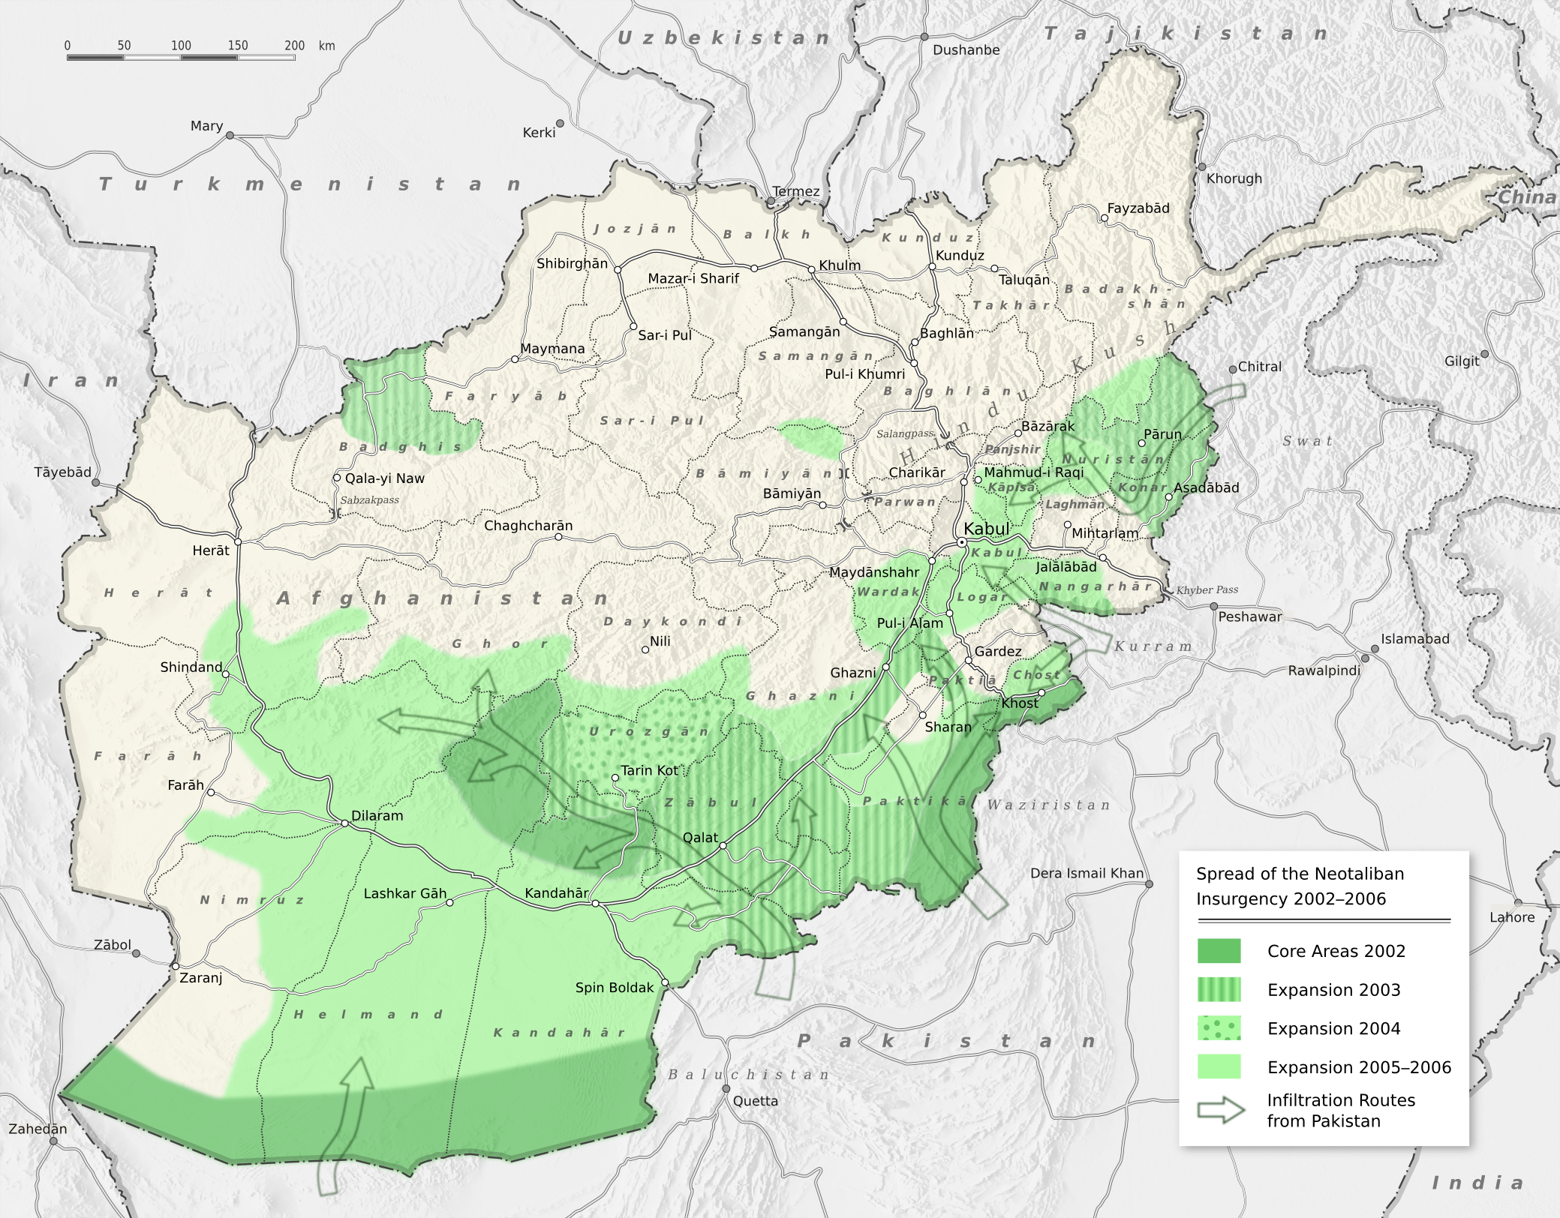
US and NATO Troops battle the Taliban
SOURCE: https://upload.wikimedia.org/wikipedia/commons/8/80/Neotaliban_insurgency_2002-2006_en.png

Slide 30
SOURCE: https://vi.wikipedia.org/wiki/Afghanistan

Slide 31
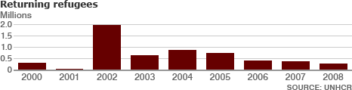
After 2001 War: Afghan Refugees return home

Slide 32
Afghani Democracy
US installed the Karazi Government
Has no power-base or militia (Mayor of Kabul)
Heavy reliance on the non-Pashtuns
Uzbek-Turkomen (Northern Alliance dominated government)
Great-Game renewed with competition between India, Pakistan, China, Iran, Russia and other countries.

Slide 33
Elections
Flawed Presidential elections in 2009
International monitors and US call for 2nd elections
Main opponent withdraws…fearing another stuffed elections
Karazi’s Brother…largest drug dealer in world, governor or Province!
Flawed elections in 2014 and 2019
Two candidates claims they won last elections

Slide 34
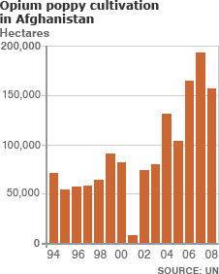
World Leader in Opium Production 50% in 2001 95% in 2009 80-90% today

Slide 35
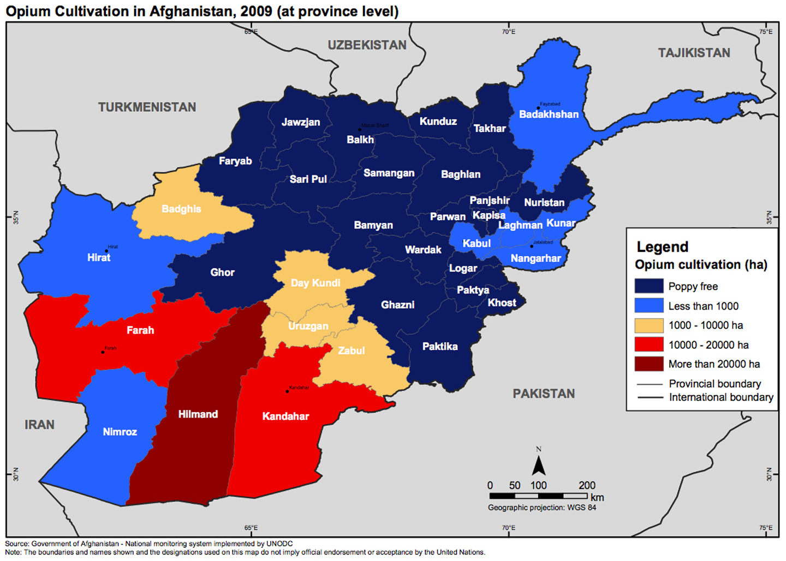

Slide 36
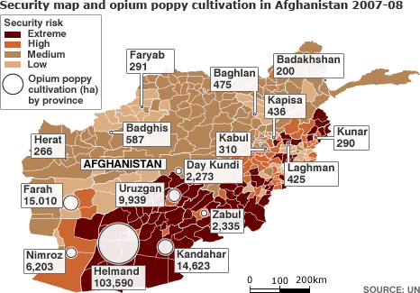

Slide 37
Future of Afghanistan
Karazi moves to appease “moderate” Taliban
US surge and downgrading of expectations
Obama: 3 times as many US troops in Afghanistan
Adoption of the Iraqi strategy
US Goal: From Democracy to relative “stability” as the primary goal!

Slide 38
2010: US offensive and Afghan peace initiative: the Iraq Strategy!
By 2010 peace efforts began. In early January, Taliban commanders held secret exploratory talks with a United Nations special envoy to discuss peace terms. Regional commanders on the Taliban's leadership council, the Quetta Shura, sought a meeting with the UN special representative in Afghanistan, Kai Eide, and it took place in Dubai on January 8. It was the first such meeting between the UN and senior members of the Taliban.
On January 26, 2010, at a major conference in London which brought together some 70 countries and organizations, Afghan President Hamid Karzai told world leaders that he intends to reach out to the top echelons of the Taliban within a few weeks with a peace initiative.Karzai set the framework for dialogue with Taliban leaders when he called on the group's leadership to take part in a "loya jirga" – or large assembly of elders—to initiate peace talks.
Karzai also asked for creation of a new peacemaking organization, to be called the National Council for Peace, Reconciliation and Reintegration. Karzai's top adviser on the reconciliation process with the insurgents said that the country must learn to forgive the Taliban.

Slide 39
Risk of a failed state
In a recent interview, former head of U.S. troops in Iraq and now the head of U.S. Central Command, General David H. Petraeus, insisted that the Taliban are gaining strength. He cited the recent uptick in attacks in Afghanistan and in neighboring Pakistan. Petraeus also insisted that the challenges faced in Afghanistan are more complicated than the ones that were faced in Iraq during his tour and in order to turn around the recent events this would require removing militant sanctuaries and strongholds, which are widespread inside Afghanistan.
Observers also have argued that the mission in Afghanistan is hampered by a lack of agreement on objectives, a lack of resources, lack of coordination, too much focus on the central government at the expense of local and provincial governments, and too much focus on Afghanistan instead of the region
AF-PAK Strategy

Slide 40
Possible long-term U.S. role and military presence
A Soldier from 91st Cavalry Regiment (Airborne) watches cattle make room for a CH-47 helicopter landing in Kunar Province.
Many of the thousands of U.S. troops in Afghanistan are positioned in what experts say are large, permanent bases.
As of January 2009, hundreds of millions of dollars were being spent on permanent infrastructure for foreign military bases in Afghanistan, including a budget of $1.6 billion for military installations at the Kandahar Air Field base, described as "a walled, multicultural military city that houses some 13,000 troops from 17 different countries – the kind of place where you can eat at a Dutch chain restaurant alongside soldiers from the Royal Netherlands Army.“
The Bagram Air Base, run by the U.S. military, was also expanding according to military officials, with the U.S military buying land from Afghan locals in different places for further expansion of the base.
In February 2009, The Times reported that the U.S. will build two large new military bases in southern Afghanistan. One will be built in Kandahar province near the Helmand border, at Maiwand – a place famous as the site of the destruction of a British army during the Second Anglo-Afghan War. The other new U.S. military base will be built in Zabul, a province now largely controlled by the Taliban and criminal gangs

Slide 41
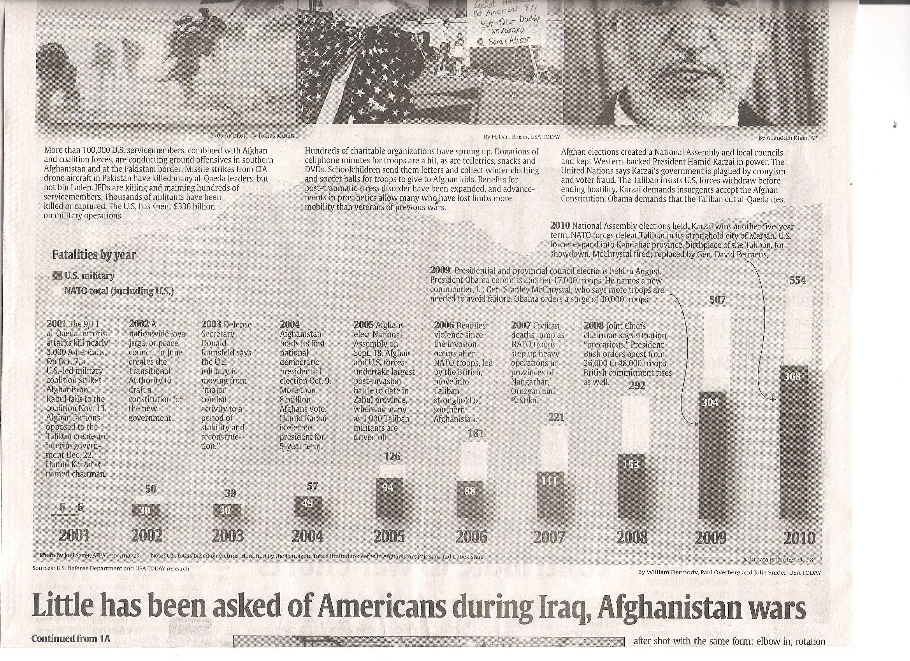
Cost in Blood and $ Going Up

Slide 42
Obama’s Strategy in Afghanistan
Military Surge : Increase troop level to 142,000
Defeat Taliban
Build Afghani military
Hand over control of country to Afghani military by 2015?
US: conditions determine American withdrawal
NATO wanted to leave by 2015

Slide 43
Way out of Afghanistan
All experts agree: No military solution to conflict
Must reach accommodation with Taliban
Power-sharing in Afghanistan

Slide 44
Trump on Afghanistan
I share the American people’s frustration. I also share their frustration over a foreign policy that has spent too much time, energy, money — and most importantly, lives — trying to rebuild countries in our own image instead of pursuing our security interests above all other considerations.
….a comprehensive review of all strategic options in Afghanistan and South Asia. My original instinct was to pull out. And historically, I like following my instincts.
I arrived at three fundamental conclusion about America’s core interests in Afghanistan:
First, our nation must seek an honorable and enduring outcome worthy of the tremendous sacrifices that have been made….
The men and women who serve our nation in combat deserve a plan for victory. They deserve the tools they need and the trust they have earned to fight and to win.

Slide 45
Second, the consequences of a rapid exit are both predictable and unacceptable. 9/11, the worst terrorist attack in our history, was planned and directed from Afghanistan because that country was ruled by a government that gave comfort and shelter to terrorists.
A hasty withdrawal would create a vacuum for terrorists, including ISIS and Al Qaeda, would instantly fill just as happened before Sept. 11. And as we know, in 2011, America hastily and mistakenly withdrew from Iraq. As a result, our hard-won gains slipped back into the hands of terrorist enemies. Our soldiers watched as cities they had fought for and bled to liberate, and won, were occupied by a terrorist group called ISIS. The vacuum we created by leaving too soon gave safe haven for ISIS to spread, to grow, recruit and launch attacks. We cannot repeat in Afghanistan the mistake our leaders made in Iraq.
Third, and finally, I concluded that the security threats we face in Afghanistan and the broader region are immense. Today, 20 U.S.-designated foreign terrorist organizations are active in Afghanistan and Pakistan, the highest concentration in any region anywhere in the world.
For its part, Pakistan often gives safe haven to agents of chaos, violence and terror. The threat is worse because Pakistan and India are two nuclear-armed states whose tense relations threaten to spiral into conflict. And that could happen.

Slide 46
Trump on Afghanistan
Use of overwhelming force MOAB
Increased troops level by 4,000!
American troops embedded with Afghani troops on front lines
Seek “honorable” peace/Exit with moderate Taliban
Secure Afghanistan not Democratic Afghanistan

Slide 47
2019 Peace Deal?
9/11 White House signing ceremony cancelled!
Why? 1 US service-man killed
Or
Optics: Taliban in the White House!!! On 9/11!

Slide 48
Peace Deal with the Taliban 2/29/2020
The U.S. and the Taliban have struck a deal that paves the way for eventual peace in Afghanistan. U.S. Special Representative Zalmay Khalilzad and the head of the militant Islamist group, Mullah Abdul Ghani Baradar, signed the potentially historic agreement Saturday in Doha, Qatar, where the two sides spent months hashing out its details:
A withdrawal of U.S. troops:
The U.S. commits to withdrawing all of its military forces and supporting civilian personnel, as well as those of its allies, within 14 months.
The drawdown process will begin with the U.S. reducing its troop levels to 8,600 in the first 135 days and pulling its forces from five bases. Rest will leave in the following 9 months.
The Afghan government also will release up to 5,000 Taliban prisoners as a gesture of goodwill, in exchange for 1,000 Afghan security forces held by the Taliban
(Afghani government refused to release prisoners on 3/14/2020…..wanted some conditions met!!)

Slide 49
A commitment by the Taliban to end support for U.S.-deemed "terrorist organizations“
U.S. officials insist the troop withdrawal timeline will depend primarily on one condition: the degree to which the Taliban fulfills its commitment in the peace deal not to allow Afghanistan to be used as a base of operations by insurgencies such as al-Qaida and the Islamic State.
This is a complex issue because the Haqqani network is often seen as a strong affiliate of al-Qaida and it's also part of the Taliban leadership
Maintaining a communications channel
The U.S. and the Taliban are expected to continue the lines of communications they have already established during the talks in Doha, both to support implementation of the agreement and to de-conflict their respective military operations against ISIS in eastern Afghanistan.

Slide 50
Intra-party talks among Afghans:
-A long-term cease-fire
These negotiations are expected to start next month. One of the first tasks in these intra-Afghan talks will be to achieve a lasting ceasefire in Afghanistan.
b. Power sharing:
The Afghan government will also begin negotiations with the Taliban to map out a political settlement which would establish the role the Taliban would play in a future Afghanistan.
c. Women's rights
"I am confident that, liberated from foreign domination and interference, we together will find a way to build an Islamic system in which all Afghans have equal rights," Haqqani wrote, "where the rights of women that are granted by Islam — from the right to education to the right to work — are protected, and where merit is the basis for equal opportunity."
Asia & Pacific: ‘Thrown under the bus’: Some Afghans view U.S.-Taliban peace deal with mix of disbelief and anger’ WP 3/8/2020

Slide 51
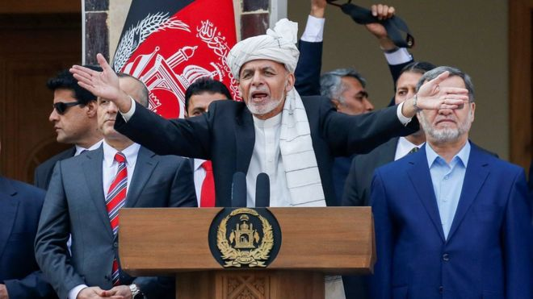
Afghanistan: Rival 'presidents' hold two inaugurations
9
Image copyrightREUTERSImage captionAshraf Ghani was sworn in as president as his rival attended his own ceremony nearby
Two Afghan politicians - who both claim they won the presidential election - have declared themselves president at rival inauguration ceremonies.
The electoral commission says incumbent Ashraf Ghani narrowly won September's vote, but Abdullah Abdullah alleges the result is fraudulent.
The old rivals both held positions in the previous government.
It comes as Afghanistan prepares to enter peace talks with the Taliban, hoping to end years of violence.
Experts warned the current political rivalry would "gravely affect the government's position in the upcoming intra-Afghan talks", which are due to begin on Tuesday.

Slide 52
Shocking Facts:
Every 30 minutes, an Afghan woman dies during childbirth
79+ percent of Afghan women are illiterate
Only 30 percent of girls have access to education in Afghanistan
1 in every 3 Afghan women experience physical, psychological or sexual violence
44 years is the average life expectancy for women in Afghanistan
70 to 80 percent of women face forced marriages in Afghanistan
“Saving Face” wins the Oscar in 2012
Source: IRIN

Slide 53
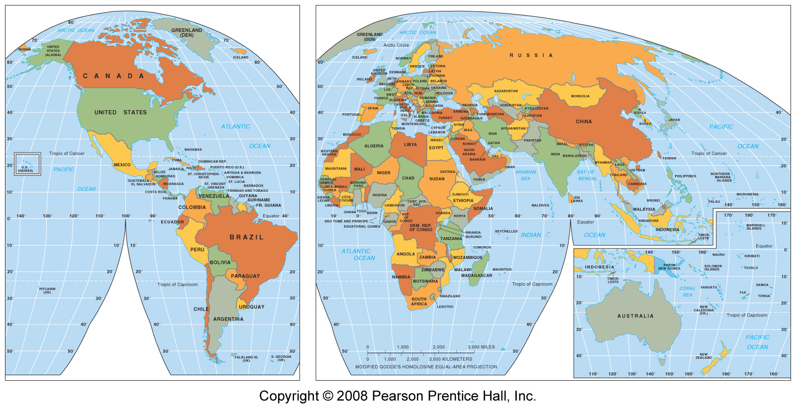
Western Asia
SOURCE: https://androidappsapk.co/detail-world-map-338749-1414472/

Slide 54
Literacy rates for Select Muslim countries (Afghanistan and neighbors)
Female Literacy Rates (2011)
Afghanistan 21%
Iran 90%+
Kyrgyzstan 96%
Turkmenistan 97%
Tajikistan 99%
Uzbekistan 96%

Slide 55
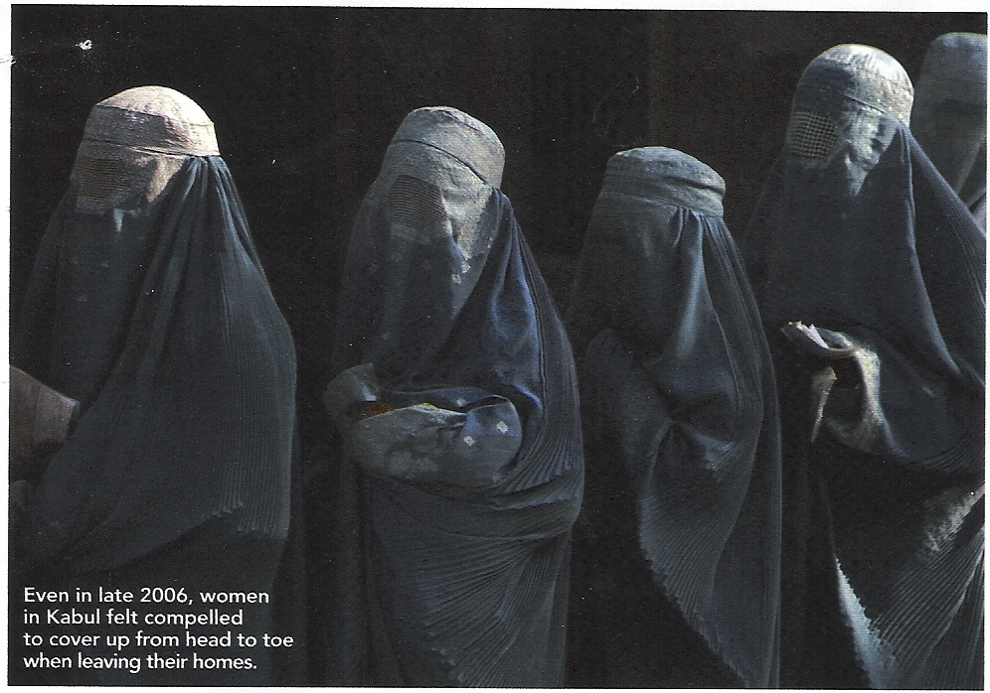
Women in “Liberated” Afghanistan
SOURCE: https://www.theguardian.com/world/unitednations/2012/dec/11/all

Slide 56
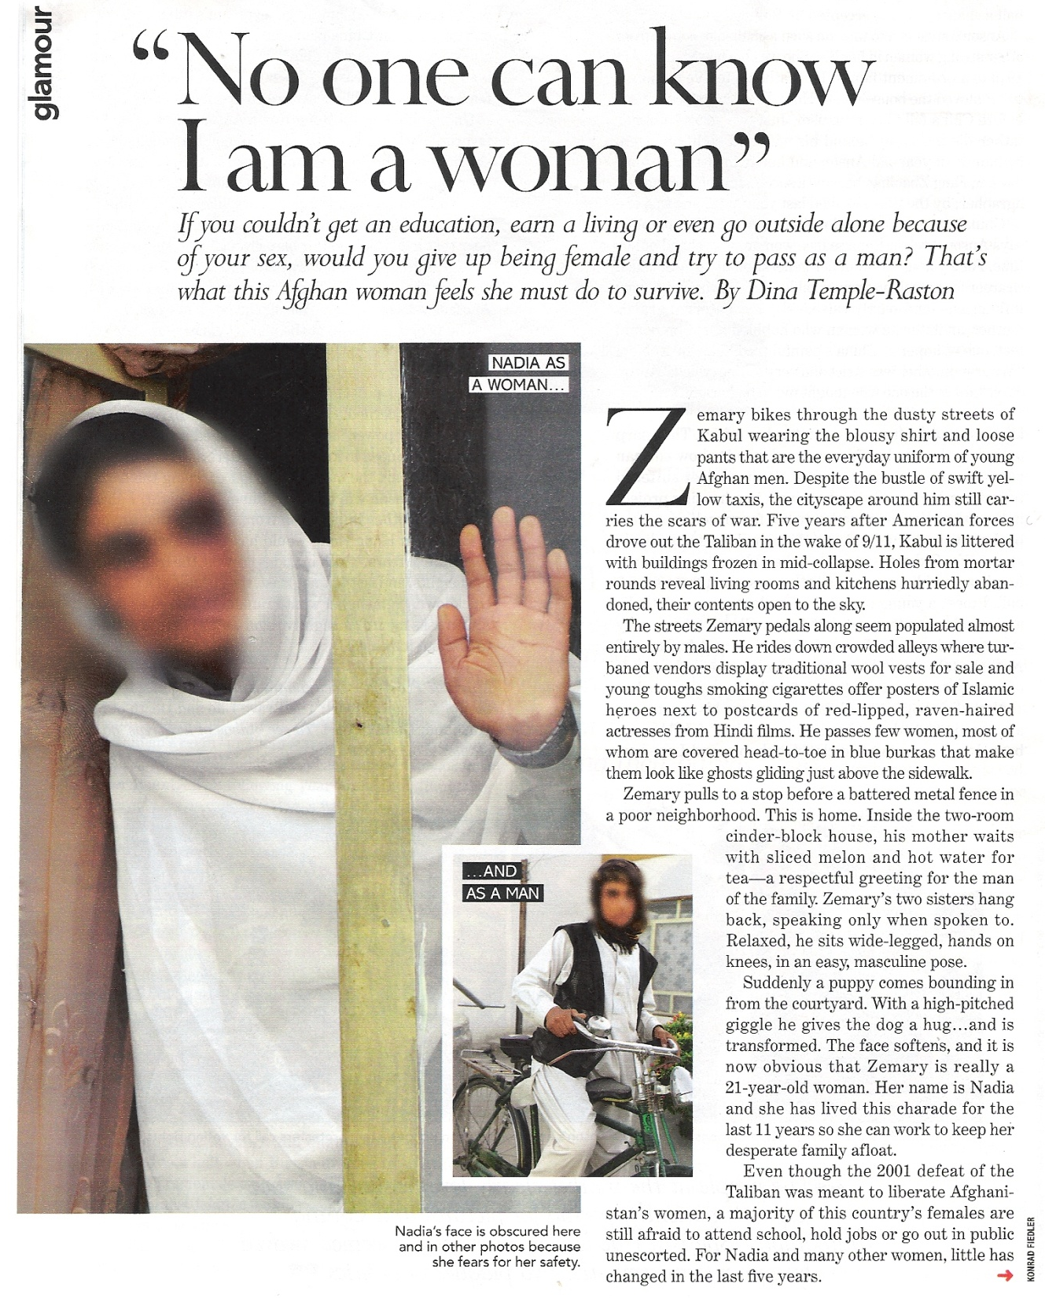
Many Osamas in Afghanistan

Slide 57
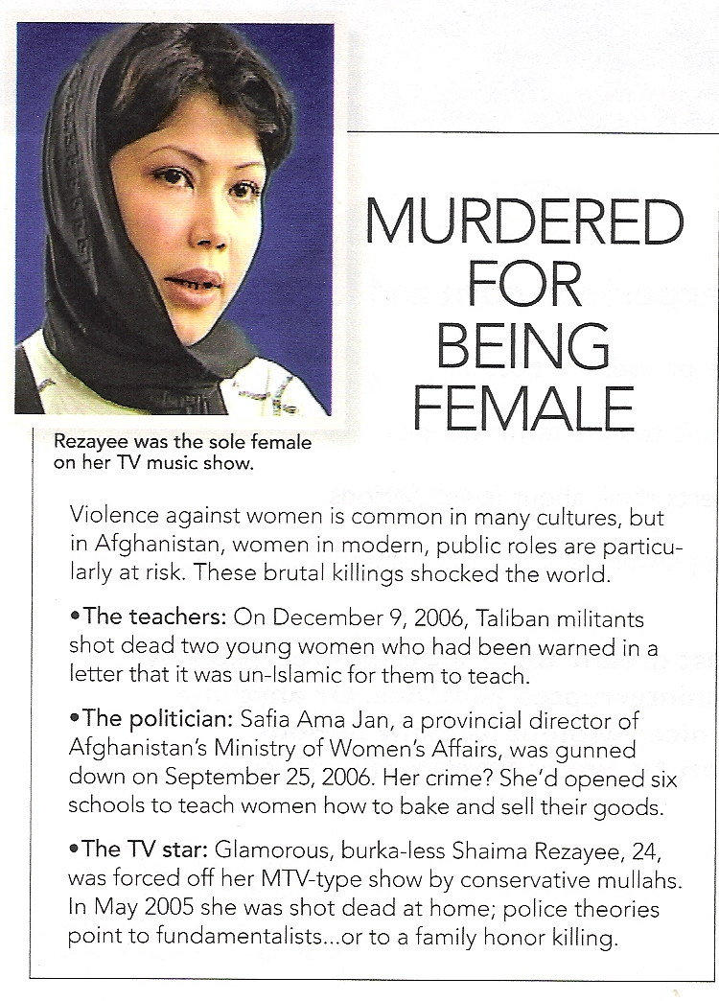
Women in “Liberated” Afghanistan
SOURCE: https://www.chicagotribune.com/entertainment/movies/chi-0505210066may21-story.html

Slide 58
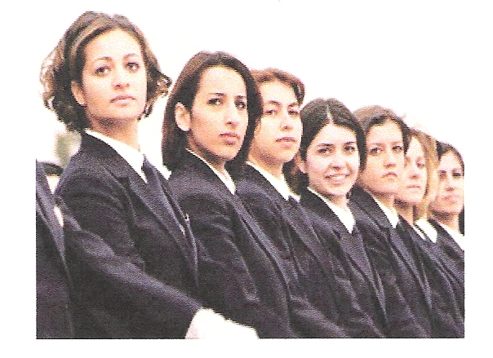
Women in 21St Century Afghanistan
SOURCE: https://www.dw.com/en/german-turkish-politician-g%C3%BCl-is-good-for-europe-turkey/a-2747725

Slide 59
Videos on Afghanistan
https://www.youtube.com/watch?v=ah5lnELw97w

